Slide 1
EMBEDDED SYSTEMS GRADUATION PROJECT (GLOVE FOR DEAF)
Youssef Nabil Elakkary

Slide 2
Objective
Deaf persons have their own language to communicate with us; the only thing is that we need to understand their language is Smart gloves. Smart gloves will provide hope to the deaf by making them able to participate in every activity of the general population.

Slide 3
METHODOLOGY
“Glove for deaf” works by analyzing the movement of the fingers by detecting the bending degree of the fingers with flex sensors, and as an output it prints its translation on LCD.
Flex sensors detect bending by increasing its resistance as it works on the bending strip principle, which means that this sensor works like a variable resistance whose resistance is changed when it is bend.

Slide 4
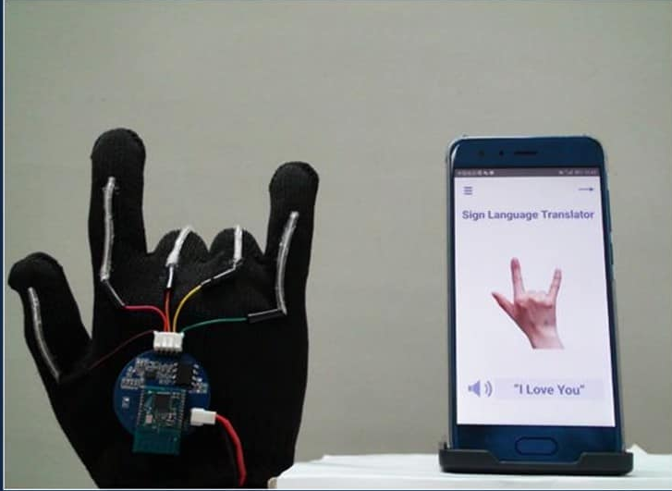
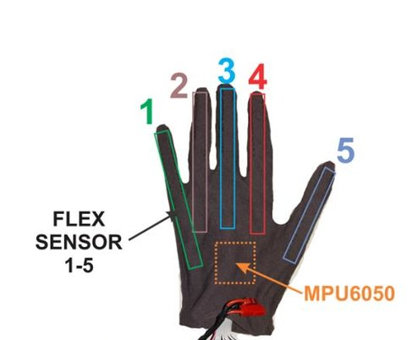
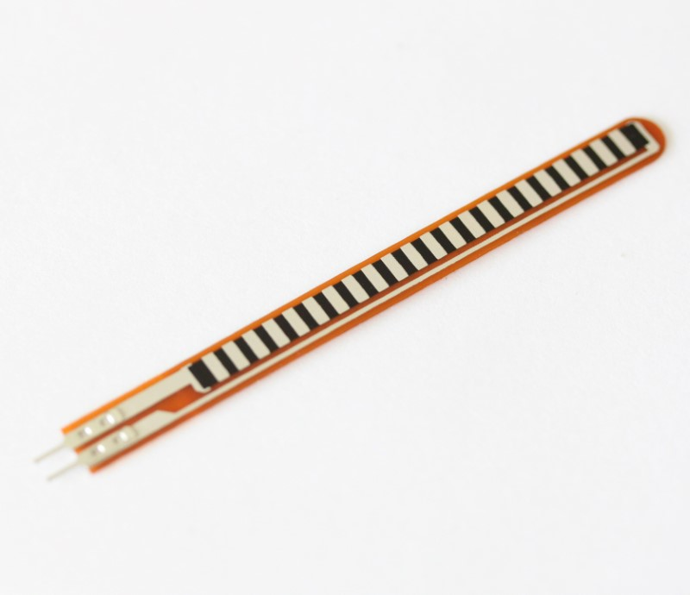
DEMONSTRATION of GLOVES AND EQUIPMENTS EXAMPLE
Glove for deaf connected with Smartphone
Flex Sensor
Glove for deaf with 5 demonstrated flex sensors (one on each finger)

Slide 5
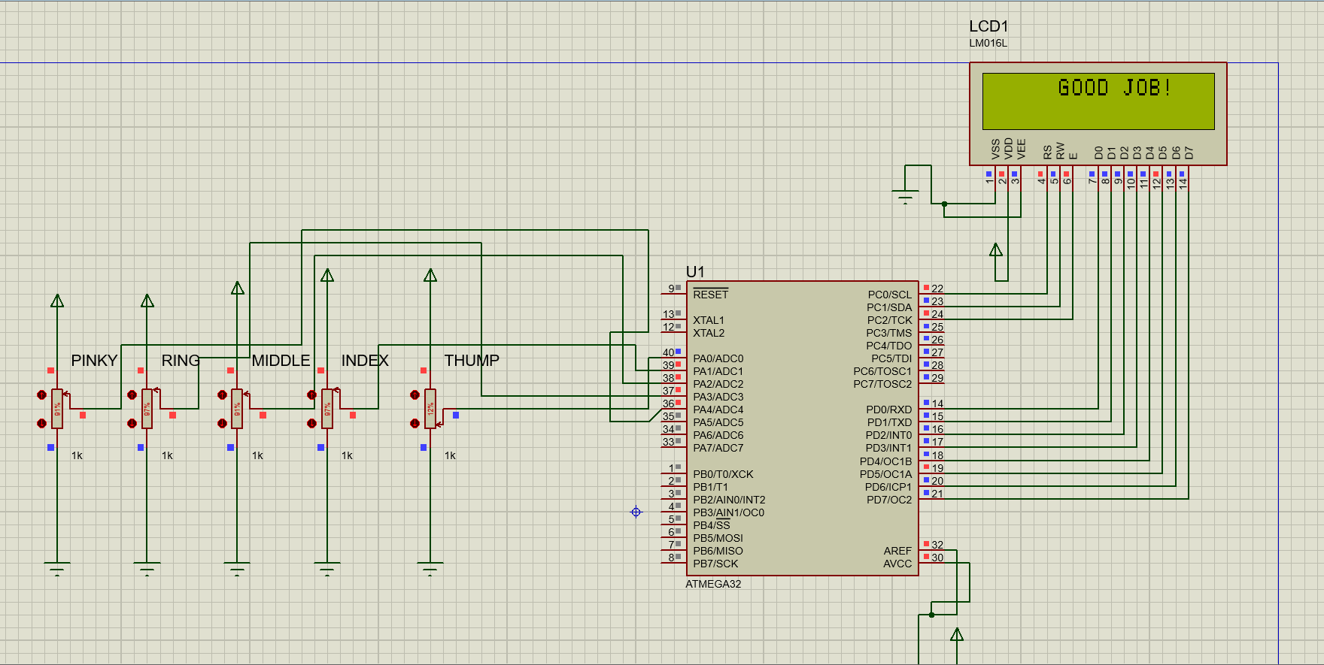

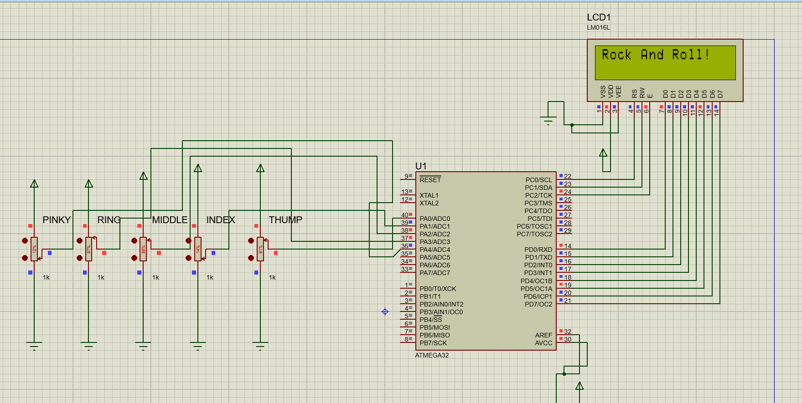
simulation
flat 0-24%
half bended 25-49%
Fully bended 50-100%

Slide 6
THANK YOU

